Slide 1


Dr. D. Y. Patil College of Engineering and Innovation, Pune
Department of Computer Engineering
A Presentation
On
Skin Disease Analysis and Prediction Using Machine Learning
Under the Guidance
Of
Dr. Jagruti R Panchal
A Presentation
On
By
Shrutika Jagtap (14202)
Mayuresh Karnavat (14211)
Rupali Khairnar (14217)
Rushikesh Kolge (14222)

Slide 2

Introduction
Skin diseases can significantly impact a person's health and quality of life if not detected and treated in time. With the increasing number of skin-related conditions and the shortage of dermatologists in many regions, especially rural areas, there is a growing need for technological support in early diagnosis.
The goal is to assist healthcare professionals and provide an initial screening tool that is fast, reliable, and easy to use.

Slide 3
Problem Statement
Delayed or inaccurate detection of skin conditions can lead to severe health complications.
Rural and underdeveloped regions often lack access to qualified dermatologists.
Traditional diagnostic methods are time-consuming and not always efficient.
A robust, automated solution is essential to bridge the gap between patients and dermatological care.

Slide 4
Project Objectives & Goals
Ensure Early Detection
  Aid in early diagnosis of skin diseases to improve treatment outcomes.
Enhance Model Reliability
  Build a robust and generalizable model using cross-validation and hyperparameter tuning.
Enable Real-time Prediction
  Optimize the backend of the web app to deliver instant disease predictions from uploaded images.
Doctor-Friendly Output
  Generate a summary report that includes prediction confidence, class label

Slide 5
Project Scope
End-to-End Pipeline
  From image input to prediction output, including preprocessing, model inference, and UI integration.
Image Preprocessing Techniques
  Include steps like resizing, augmentation, and color normalization to improve input quality.
Deployment Scope
  Local server deployment using Flask/Django or cloud deployment via platforms like AWS.
Dataset Handling
  Automated scripts to manage large datasets, create train/test splits, and handle class imbalance if present.

Slide 6
Methodology / Approach
Dataset: HAM10000 (sourced from Kaggle)
Data Preprocessing: Image resizing, normalization, label encoding, train-test split.
Algorithm Implemented:
  Convolutional Neural Networks (CNN)
Web Development Stack:
  Backend: Django (Python)
  Frontend: HTML, CSS, Bootstrap
  Database: SQLite

Slide 7
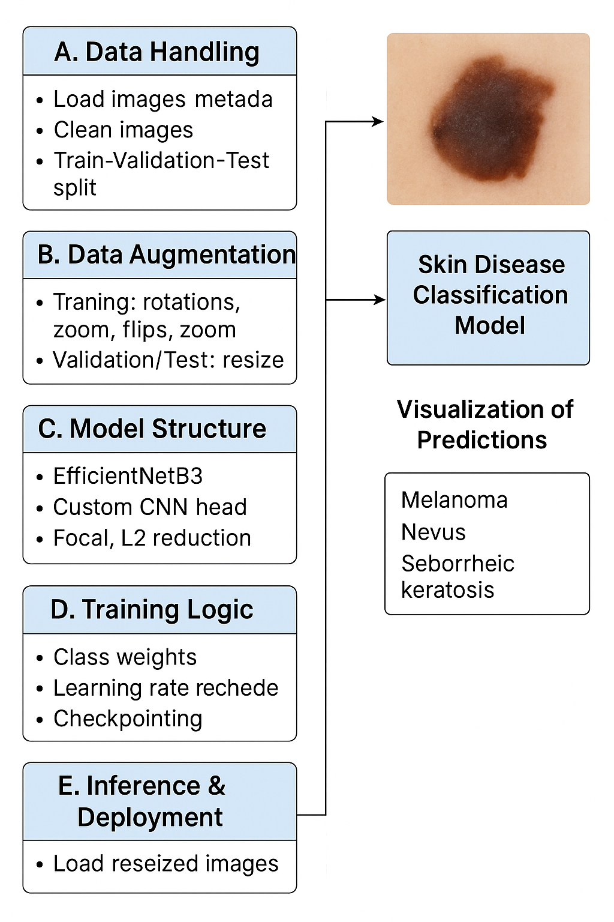
Workflow

Slide 8
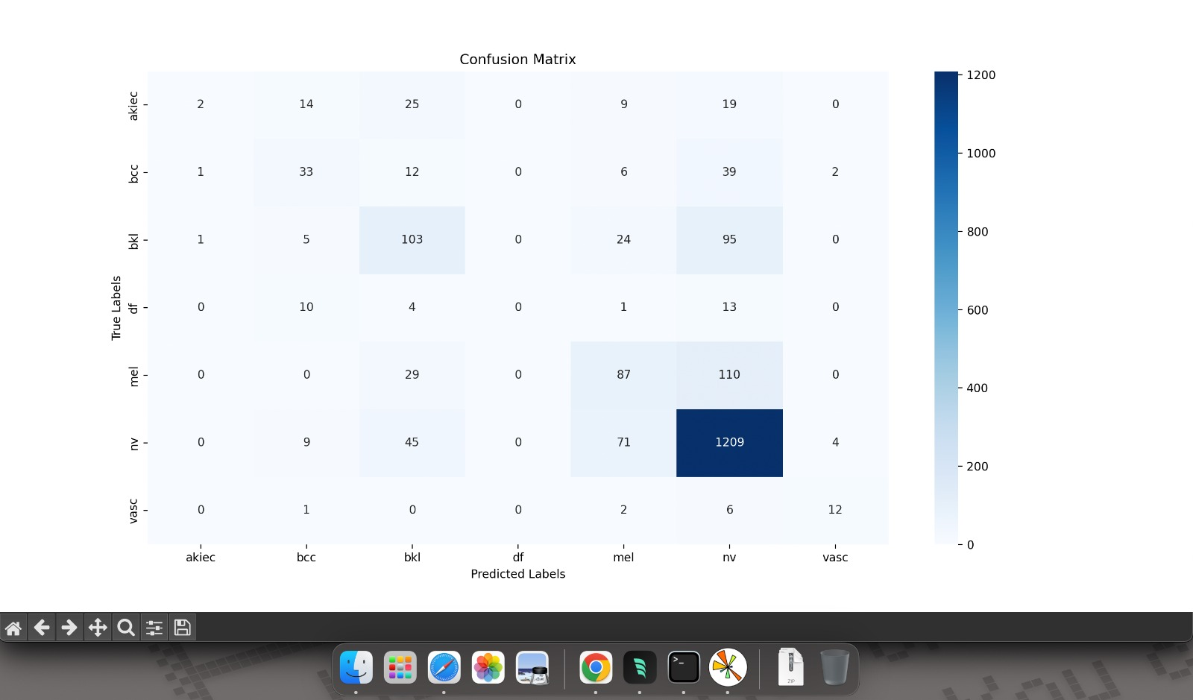
Confusion Matrix
From 226 melanoma images:
87 were correctly predicted.
29 wrongly predicted as bkl.
110 wrongly predicted as nv

Slide 9
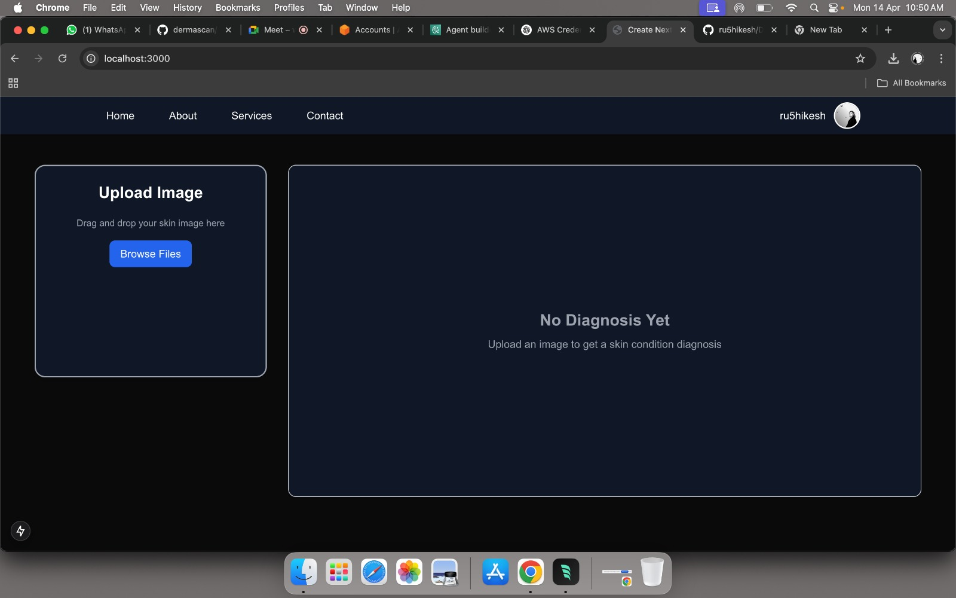
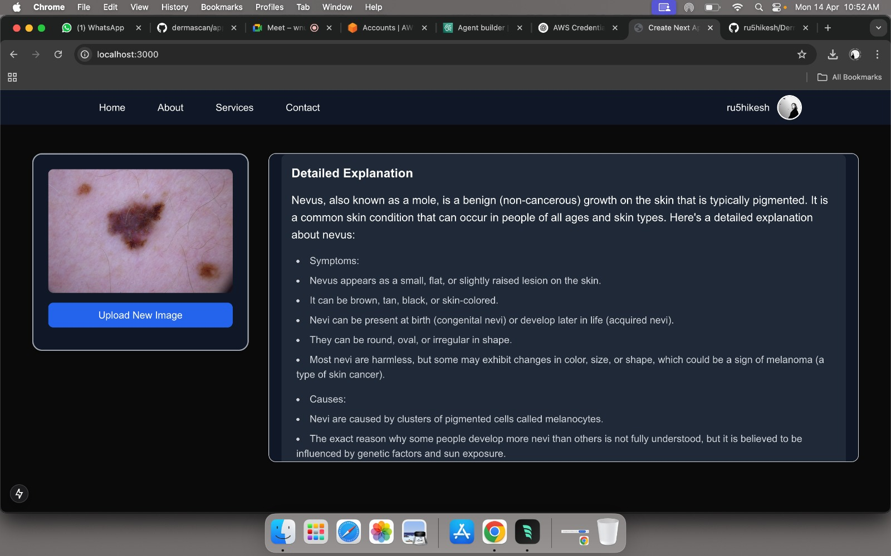
Results / Findings
Achieved an overall prediction accuracy of 72.19%, using CNN.
CNN models outperformed traditional ML classifiers in both accuracy and generalization.

Slide 10
Conclusions
The project validates the applicability of machine learning for dermatological diagnosis.
The developed CNN model provides reliable predictions on commonly found skin lesions.
A graphical user interface (GUI) enhances usability for both patients and healthcare professionals.
The system supports dermatologists in decision-making and contributes to early-stage intervention.

Slide 11
Future Work
Adding a dermatologist's business page.
Integration of hospital locations.
Integrate advanced deep learning architectures like ResNet and MobileNet.
Expand dataset for better class balance and improved generalization.
Enable real-time image analysis through webcam or mobile input.

Slide 12
References
https://ijarsct.co.in/Paper22113.pdf
https://ieeexplore.ieee.org/document/10047634
https://ieeexplore.ieee.org/document/10051620
https://ieeexplore.ieee.org/document/9707838
https://www.sciencedirect.com/science/article/pii/S2772442522000624
https://www.researchgate.net/publication/341371302_Machine_Learning_Algorithms_based_Skin_Disease_Detection

